Slide 1


BOSCH REXROTH – INDUSTRIAL PRODUCT PERFORMANCE & COST ANALYTICS DASHBOARD
Tool Used
Microsoft Power BI
Domain
Production Analytics
Presented By
Oviya Priya R

Slide 2

Introduction
Problem Statement
Bosch Rexroth is an industrial automation and manufacturing solutions company.
Manufacturing companies need real-time monitoring of production cost & efficiency.
This dashboard helps analyze product performance and cost trends.
Difficult to track production cost manually
Hard to identify cost variance
No clear visibility on department-wise efficiency
Time-consuming monthly report preparation

Slide 3
Project Objective
Tools & Technologies Used
Analyze total production cost
Compare planned vs actual cost
Measure production efficiency
Department-wise performance analysis
Identify cost variance
Power BI
Excel (Data Source)
DAX (for calculations)
Technologies
Calculated Columns and DAX measures for KPIs
Visuals like cards, charts
Applied slicers for Day, Product

Slide 4
Dashboard Overview
KPI Cards:
Total Production Cost – 70M
Planned Cost – 354K
Actual Cost – 362K
Efficiency – 128.75
Production Variance – 7K
Key Visualizations:
Production Cost by Month (Line Chart)
Cost by Department (Column Chart)
Cost by Year (Donut Chart)
Cost by Shift(Waterfall Chart)
Table by YTD & MTD
Slicer for (Day, Department)

Slide 5

Business Features
Real-time production cost and performance monitoring
Planned vs Actual cost comparison for financial control
Department-wise and shift-wise efficiency analysis
Cost variance identification to reduce excess expenses
Interactive dashboard with filters for better decision-making

Slide 6
Conclusion
Provides a clear and interactive view of production performance and cost analysis.
Helps compare planned vs actual costs to improve operational efficiency.
Supports data-driven decision-making for better cost control and productivity.

Slide 7
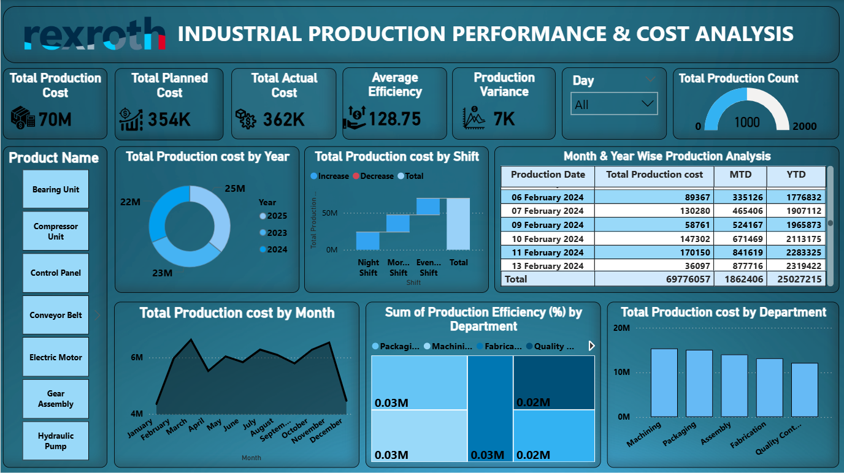
Dashboard Overview

